Slide 1
EES203: Geochemistry
Instructor: Anoop Ambili
Email id: anoop@iisermohali.ac.in

Slide 2
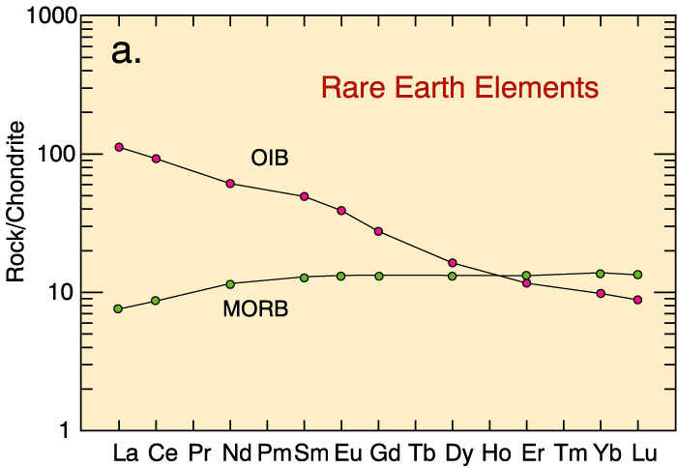
Rare Earth Elements as indicators of petrogenesis (melting source)
increasing incompatibility

Slide 3
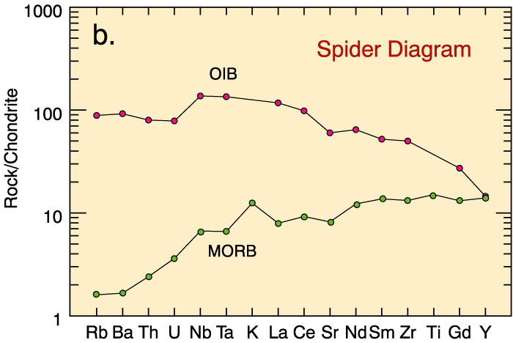
Spidergrams or Spider-diagrams
increasing incompatibility

Slide 4
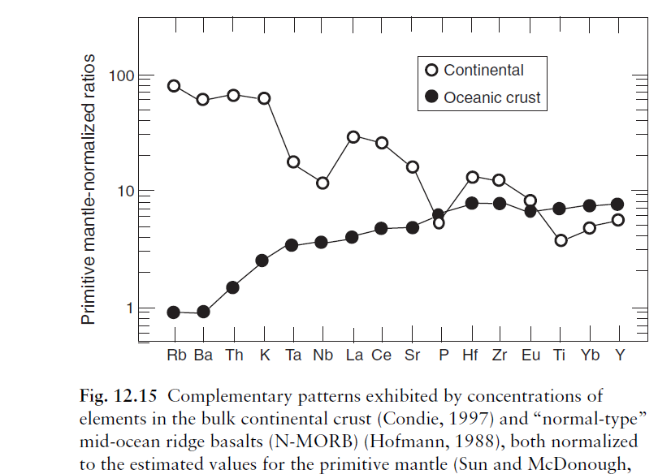

Slide 5
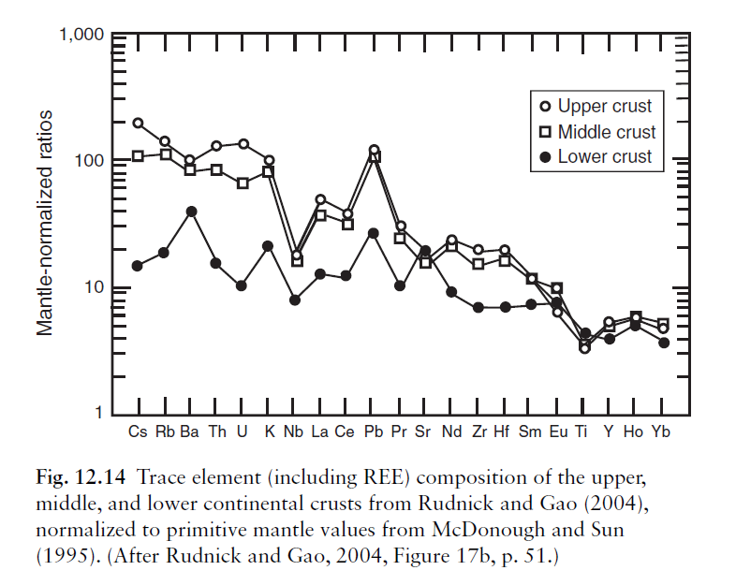

Slide 6
Geochemical evolution through time

Slide 7
Divisions of Geologic Tim13 e
Based on the fossil record, major changes in life forms occurred at certain times.
These changes were used to mark the boundaries between units of geologic time.
Divisions of the geologic time scale depend on significant events in the history of life on Earth.

Slide 8
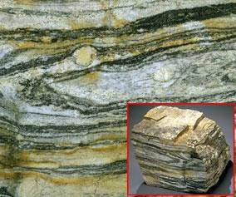
Age of the Earth
Earth:
Earth formed within 50 Myr of oldest meteorite components (CAI’s), which are 4,567.3 ± 0.12 Ma.
Accretion (incl. Moon) complete by 4.52 Ga.
Oldest minerals (zircons) from much younger sedimentary rocks in W. Australia:
4.30 Ga.
4) Oldest rocks: Acasta gneiss (NW Canada): 4.03 Ga.
Other rocks from Greenland, W. Australia, Antarctica, China, Wyoming are 3.80~3.96 Ga.

Slide 9
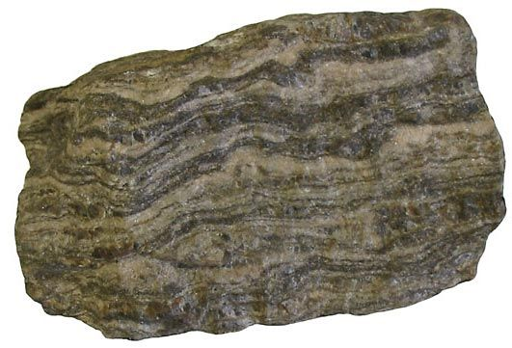
4.03 billion-year-old
Acasta Gneiss, NW Canada: oldest known intact piece of Earth’s surface

Slide 10
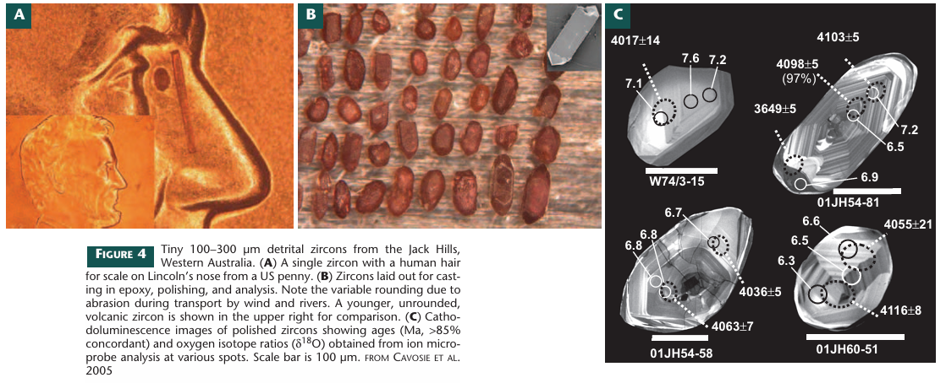
Valley (2006) Elements 2:201

Slide 11
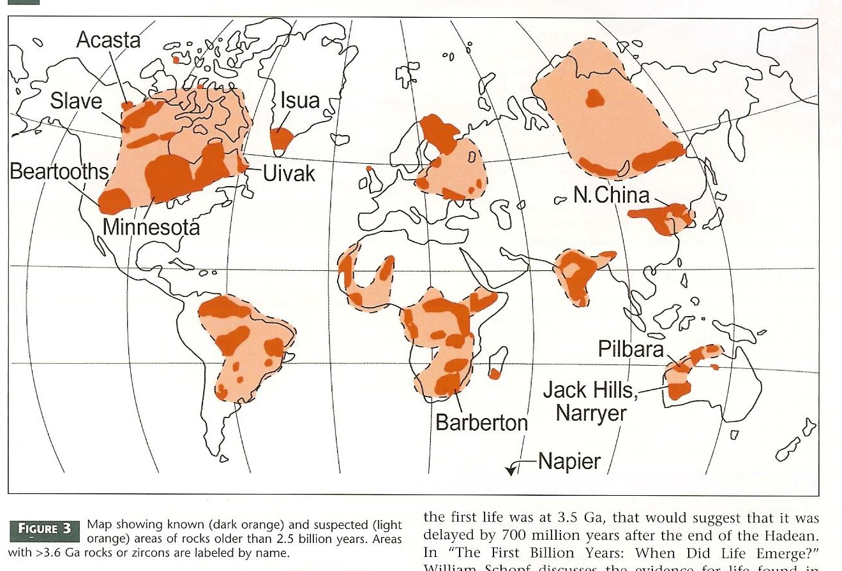
Rocks older than 2.5 Ga

Slide 12
Divisions of Time
14
▶ EON – largest division of geologic time
▶ ERA – 2nd largest, includes two or more periods
▶ PERIOD – 3rd largest, unit into which eras are divided
▶ EPOCH – 4th largest, the subdivision of a period EON > ERA > PERIOD > EPOCH

Slide 13
EONS
15
▶ Hadean – rocks from meteorites and moon
▶ Archean – earliest rocks on earth form “Greek word arkheios, meaning "ancient" or "beginning."
▶ Proterozoic – organisms with well developed cells “earlier life”
▶ Phanerozoic – means “visible life” well represented in the fossil record

Slide 14
Eons:
Precambrian: Earliest span of time
Phanerozoic: Everything since
Eras: Paleozoic Mesozoic Cenozoic
Periods: Cambrian Ordovician Silurian Devonian
Carboniferous
(Missipp. & Pennsylvanian)
Permian Triassic Jurassic Cretaceous Paleogene Neogene Quaternary
Paleozoic
“Age of
Invertebrates”
Epochs: Paleocene Eocene Oligocene
Mesozoic
“Age of Reptiles”
Cenozoic
“Age of Mammals”
Miocene
Pliocene
Pleistocene Holocene

Slide 15
ERAS
▶ Paleozoic – “early life”
544 → 244 mya
▶ Mesozoic – “middle life”
245 → 66 mya
▶ Cenozoic – “recent life” 66mya → present

